Slide 1
Food. Poison. Medicine.
Have you got what it takes to survive?

Slide 2
Humans have relied on plants throughout history.
Plants have been used, and continue to be used today, for; food, shelter, clothing, weapons, tools, medicines, building materials, cosmetics, poisons, fuel and much more besides.
Taking it back to basics, to know what a plant is useful for, you first need to know what it is.
Faced with your own survival, do you have the skills to thrive?
Notes:
Alternatively, get students to come up with as many plant uses as possible in their groups and create a class list.

Slide 3
Your first challenge…
Decide on your team! Once in your team, divide yourself into two:
Half are responsible for describing how to identify each plant.
Half are responsible for foraging for the correct plant.
Using the information given, match the plant with its description.
Good luck!
Notes:
Students will need to work in teams for this activity. Teams of 4-6 pupils works well. Once in a team and students have decided on who are describers and who are foragers, ensure students in each half of the team don't get to see the plant image or description from the other half of the team. They need to communicate clearly to be successful. You could arrange it so the two halves of each team are physically distant from each other (e.g. at either side of a classroom) so they have to remember the relevant information between describing and foraging. The activity works best if the plant images and plant descriptions are handed out to the relevant half of the team once they are ready to begin. Once they have matched images and descriptions they can come back together as a team and be given the names to add.

Slide 4
Can you add names to your plants?
Have a go! Maybe there are some plants you recognise? Don’t worry if not, its all part of the game.
Notes:
Once students have matched the plant images with the descriptions they can have a go at adding a name to each plant – they may recognise and be able to name some of the plants e.g. tomato, aubergine. It doesn’t matter if not as the correct answers will be revealed in the next slide.

Slide 5
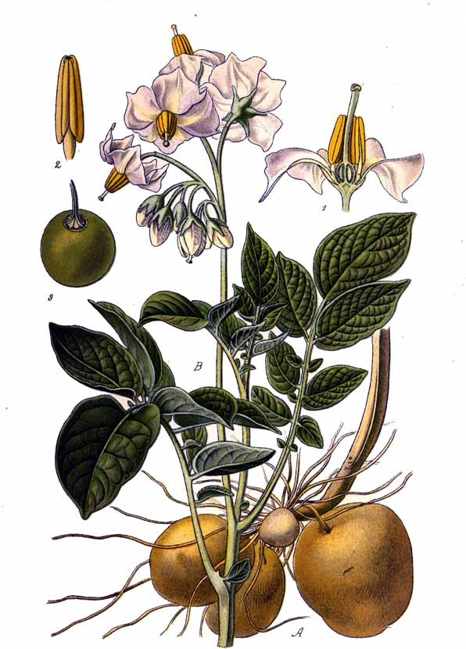
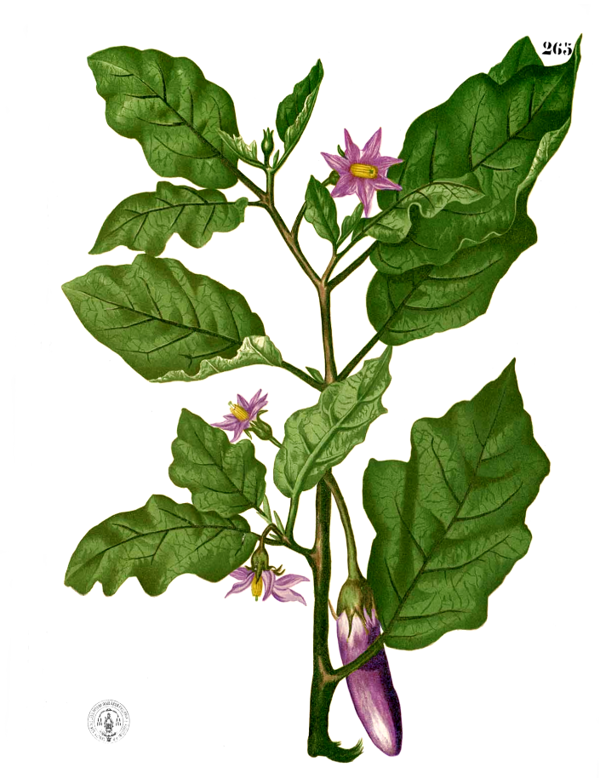
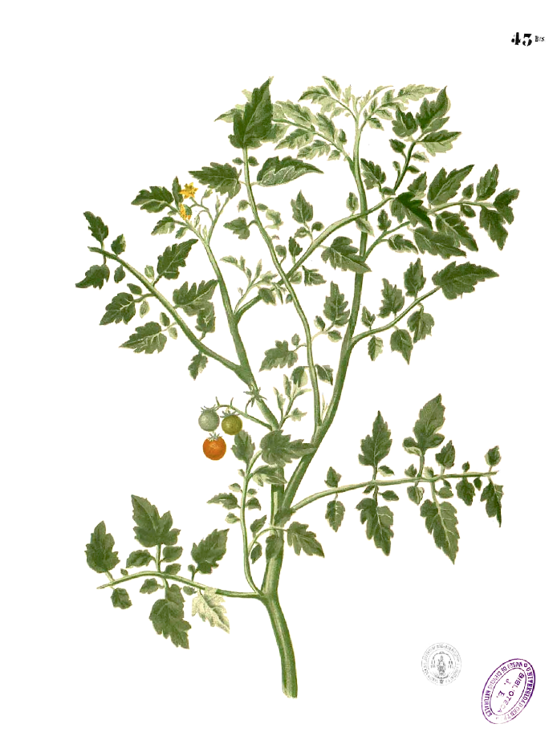
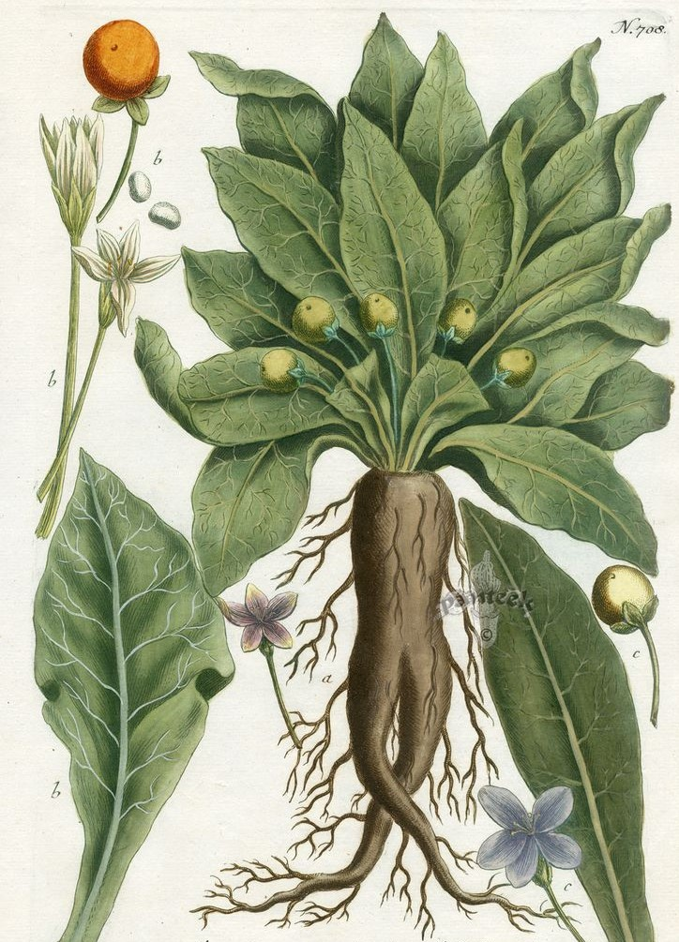
Answers…
1. Potato
2. Aubergine
3. Tomato
4. Mandrake
Notes:
Check your answers – did you get the names of each plant right?
Hand out answer sheets or read out the description for each plant. Did they get them right? Re-arrange so that they are matched correctly.

Slide 6
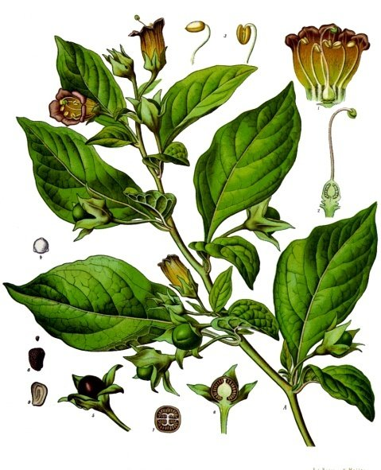
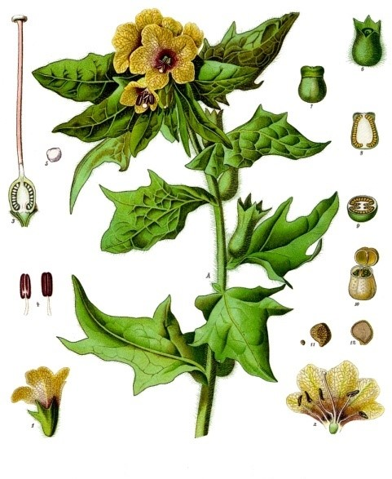
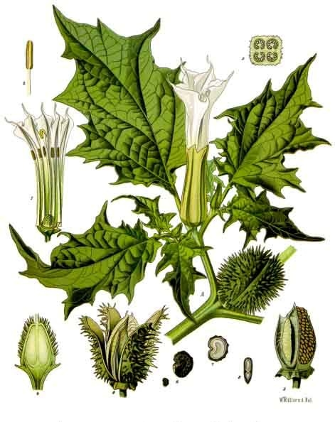
5. Deadly Nightshade
6. Henbane
7. Devil’s Snare
Notes:
Check your answers – did you get the names of each plant right?

Slide 7
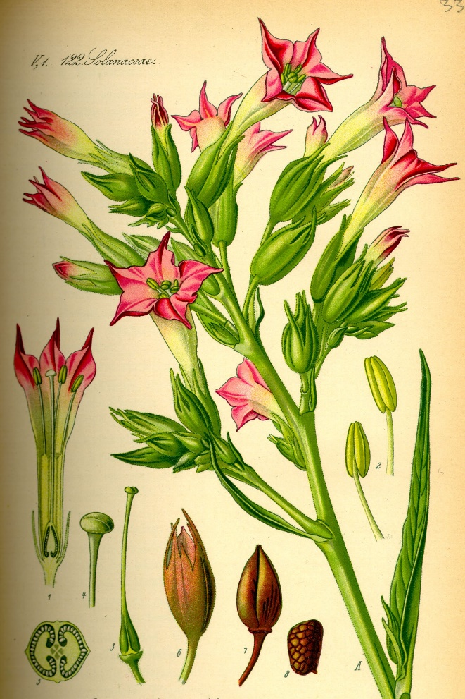
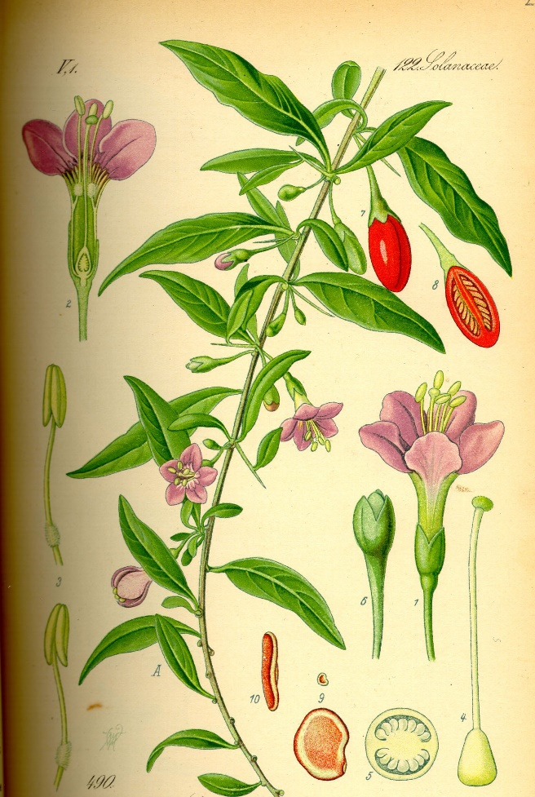
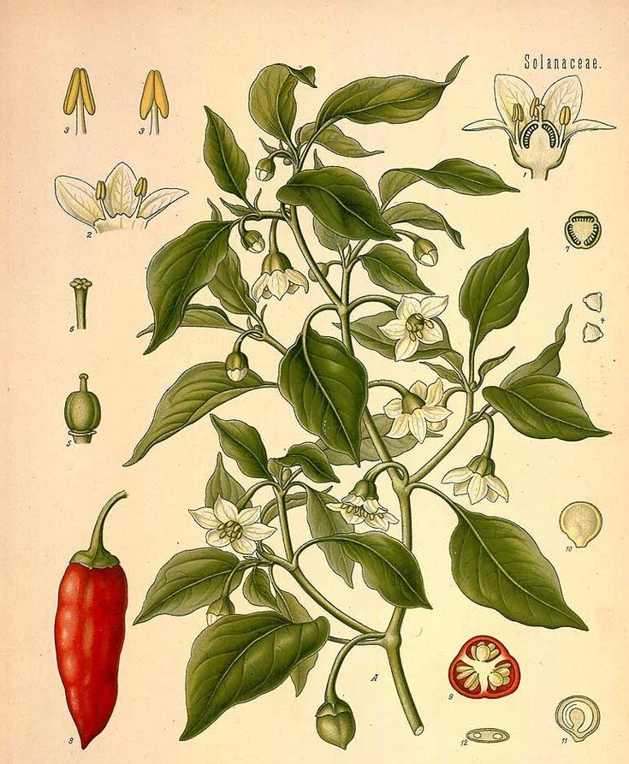
8. Tobacco
9. Gogi Berry
10. Chili Pepper
Notes:
Check your answers – did you get the names of each plant right?
Hand out answer sheets or read out the description for each plant. Did they get them right? Re-arrange so that they are matched correctly.
Q. In what way are illustrations of plants useful for identification? What advantage do they have over a photograph?
A. They show all parts of the plant at one time which wouldn’t be seen at the same time in reality, e.g. flowers and fruit together. They also show a 'typical' specimen of the plant.

Slide 8
Your first challenge…
Did you get it right? Has anyone been poisoned?
Which plants are hard to tell apart and easily confused for each other?
For those plants, have another close look at them side by side and make a note of any distinguishing features to avoid misidentification next time.
Notes:
Feedback to class.

Slide 9
Next…
Once you think you have correctly identified and foraged all of your plants, you must sort them.
First, sort them into: Edible, Poisonous or Medicinal. Make sure you discuss your answers as a team and that everyone is happy with your decisions.
Notes:
Sorting their plants into edible, medicinal, poisonous is based on reading the plant descriptions, discussing as a team and any prior knowledge students may have. There are many different ways the plants could be sorted and its not straightforward. The main purpose of this part of the activity is to encourage discussion as a team.

Slide 10
Answers…
Edible
Aubergine
Chili Pepper
Gogi Berry
Potato
Tomato
Poisonous
Deadly Nightshade
Devil’s Snare
Henbane
Mandrake
Tobacco
Medicinal
Chili Pepper
Deadly Nightshade
Devil’s Snare
Henbane
Tobacco
Notes:
Its not that easy to sort neatly into three is it? Many of the plants have multiple uses depending on which part of the plant you are using and so fit into multiple categories. All the plants in the ‘Edible’ column also have parts which are toxic and would make you sick if you ate the wrong bit (but that aren’t as highly poisonous as some of those plants in the poisonous column).
Q. Is there a better way to sort? How could you sort them more accurately?

Slide 11



Edible
Aubergine
Gogi Berry
Potato
Tomato
Chili Pepper
Poisonous
Medicinal
Devil’s Snare
Deadly Nightshade
Henbane
Tobacco
Mandrake
Notes:
How about like this? Would it work better?
This way of sorting allows plants to fit into multiple categories.

Slide 12
Food. Poison. Medicine.
Are there any plants that you know or recognise? Any that you have eaten? Does anything surprise you about these plants?
Discuss in your team.
Notes:
Discuss in teams and feedback to the class.

Slide 13
Finally…
Once you have sorted your plants you have a decision to make.
You can only keep three of your foraged plants. They all have their uses but which three will you choose?
You need to have a convincing argument for each plant you wish to keep otherwise it may be taken from you and you’ll end up with none!
Notes:
Think about the properties of the different parts of the plant (edible, medicinal, poisonous) but also what will happen to the whole plant once that part has been harvested. Fruits can be picked without killing the plant and also contain seeds which you could plant to grow more. Roots and tubers will need to be dug up to be used and the plant won’t survive without them though tubers can also be planted to produce a new crop… there are no right or wrong answers of which plants to keep, just make sure you are all in agreement as a team, have thought through your answers and have good reasons to support your choices!

Slide 14
So…
Which plants did you keep?
Why? Justify your decisions.
Notes:
Feedback to class.

Slide 15
Plant families
All of the World’s plants are currently grouped in 620 different plant families.
All of the plants you ‘foraged’ for earlier in your teams are members of the same plant family, Solanaceae, also known as The Nightshade Family.
Why might it be useful to know which family a plant belongs to?
Notes:
Plants have families just as animals do (think of the members of the big cat family for an animal example).​
​
Often, members of the same family will have features in common with each other and by knowing a characteristic, for example, leaf shape of one member of the family, you may be able to hazard a guess at which other plants belong to that family too, even if you don’t know exactly what species they are.​
​
Knowing which family a plant belongs to can help us make an educated guess about what the plant might be like and what characteristics it may have, whether its likely to be poisonous, a possible food plant, or a plant that could have other uses such as fibrous stems to make rope or fabric, or useful compounds within its leaves. Sometimes plants from within a family need similar growing conditions and can suffer from similar pests and diseases so it can also be useful when thinking about the best conditions for growing a particular plant.​
​

Slide 16
Plant families
The Nightshade Family, Solanaceae
What characteristics or features do your foraged plants have in common?
Notes:
​There are around 2,700 species of plant in the Nightshade or Solanaceae family.
There is great diversity within this family, but some common features for the majority of members include:
Five-petaled flowers, typically conical or funnelform in shape.
Alternate or alternate to opposite leaves.
Colourful berry-like fruits (typically, berries are fleshy, rounded, brightly coloured and do not have a stone or pit, although many pips or seeds may be present. They are indehiscent which means they do not split open to release their seeds when ripe).
Many members of this family contain potent alkaloids and some are highly toxic.
This family contains a number of agricultural crops, medicinal plants, spices weeds and ornamentals.

