Slide 1

Amazing Adaptations

Slide 2
What are adaptations?
Adaptations are features that animals and plants have which allow them to live successfully in their habitats.
Can you think of any?

Slide 3
Plants really are amazing.
They have to do all the things that animals do to survive….. but without being able to move!
They have evolved some ingenious ways of surviving and thriving in the habitats where they grow.
Lets find out more about some of their amazing adaptations!
Notes:
Today we are going to find out about some of the amazing adaptations that plants have evolved to be able to cope with the conditions where they grow. Cambridge Botanic Garden grows plants from all around the world but here we are focusing on plants that grow in some of the most extreme conditions which we grow in our glasshouses. We are focusing on plants: the mountains glasshouse, the rainforest glasshouse and the desert glasshouse.

Slide 4
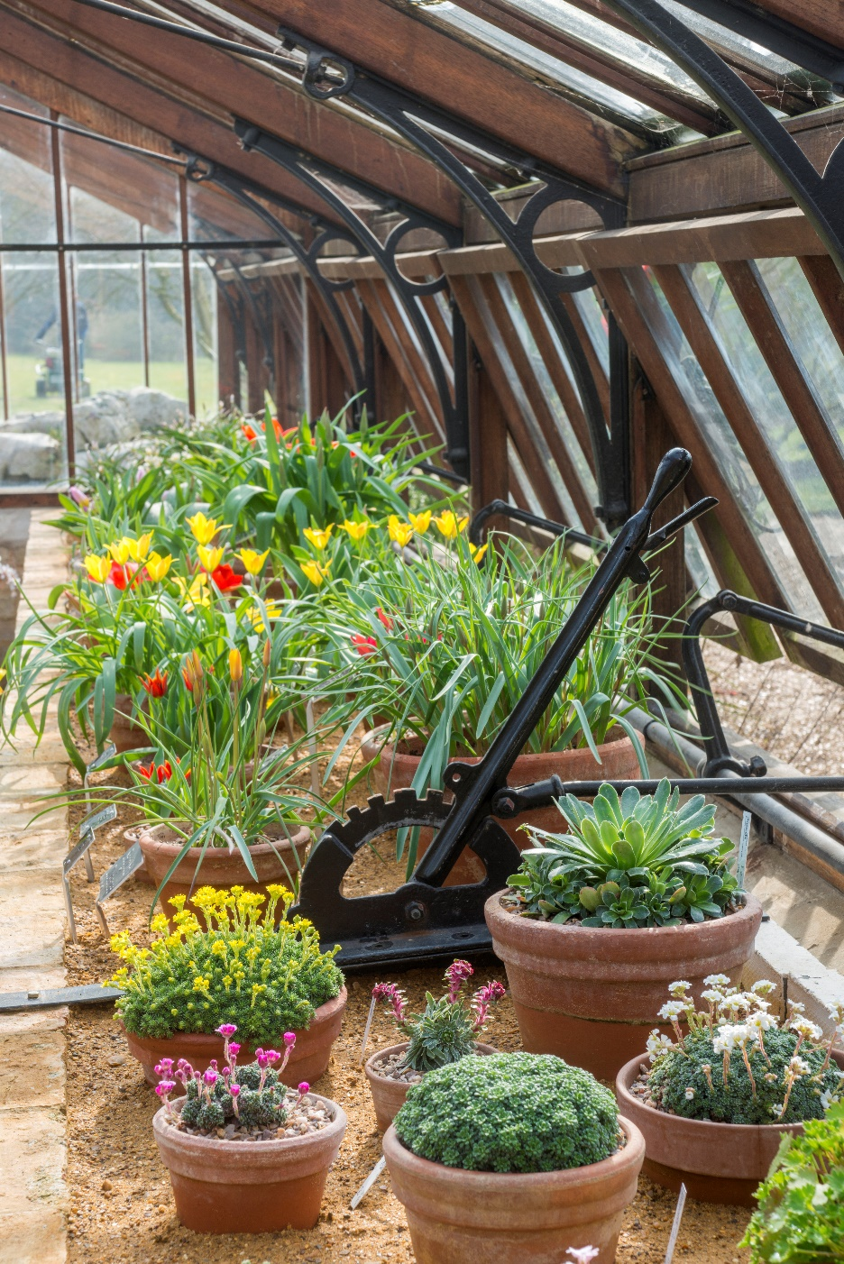
Life on a mountain: what might it be like?
Cold with snow and ice
Windy and exposed
Strong sunlight
Rocks and not much soil
Notes:
Imagine you’re on top of a mountain, what might it feel like? What might the conditions be like? What would you need to take with you to survive?
It can be very cold up high on a mountain, there might even be ice or snow! This means there isn’t much water for plants to suck up through their roots because its all frozen!
Often there isn’t much soil high up on a mountain as its mostly rock and its steep so soil doesn’t accumulate. That means there’s not much soil for plants to grow in, some mountain plants are able to grow in tiny cracks in the rock.
Up high on a mountain the sun can be very strong with high levels of ulra-violet light, even when its cold. Plants are in danger of being sunburnt!

Slide 5
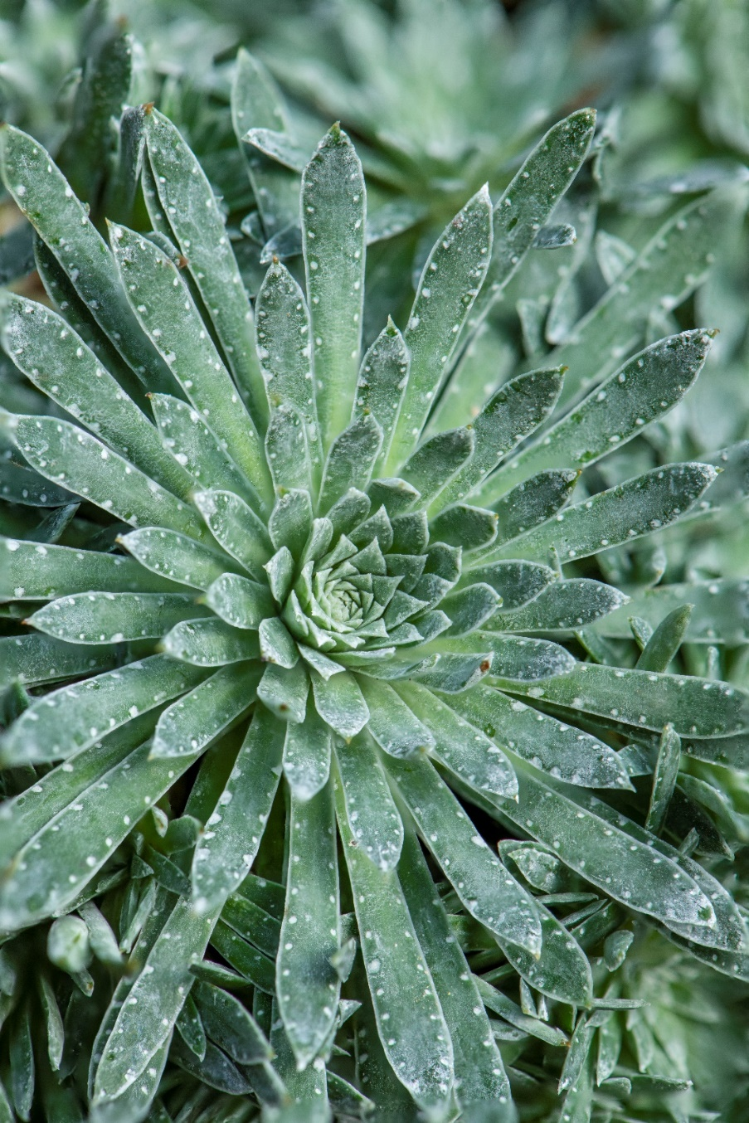
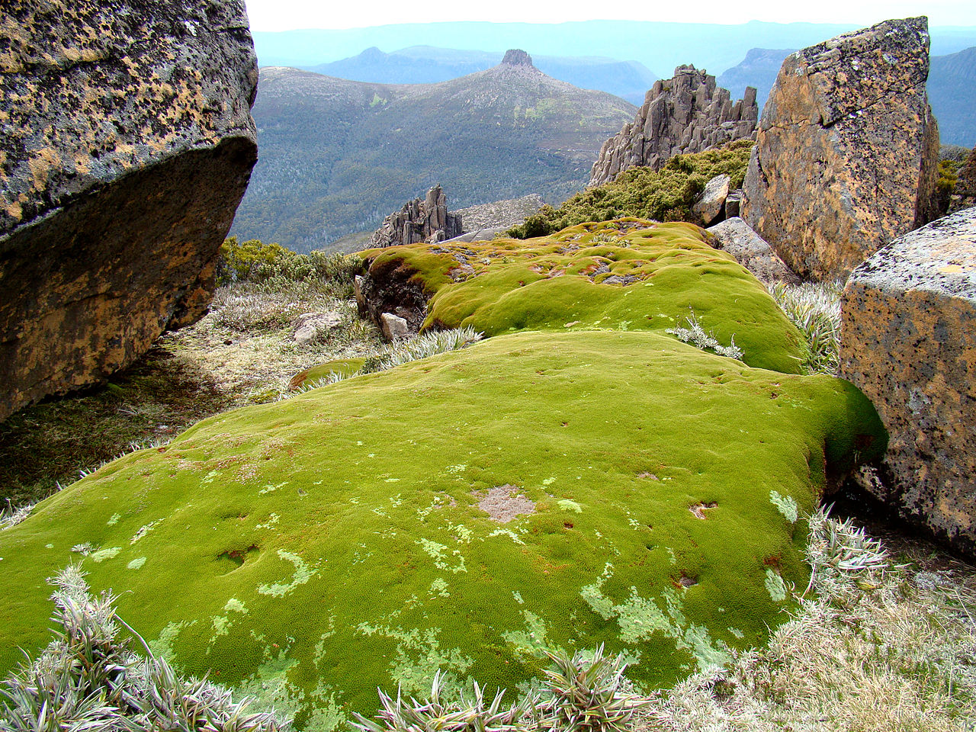
Life on a mountain
Notes:
Features of mountain plants to help them to live successfully in these conditions:
Slow growing, most only actively grow during the Spring/Summer because of the harsh conditions and low temperatures at other times of year.
A typical mountain plant has a strong, low growing shape to withstand the weight of snow and avoid the wind. No one branch sticks out above the rest.
Succulent leaves store water – plants can’t take up water through their roots if its frozen as ice/snow so for part of the year there isn’t much available water. Because the soils are thin and rocky, what water there is, for example when the snow melts, runs off quickly.
Hairy leaves also help to reduce the amount of water lost through the leaf, if its windy then leaves are prone to drying out much more quickly (think drying washing on a washing line!) and hairs slow this down by ‘trapping’ the water.
Hairy and silver leaves protect against the sun and damaging UV rays. They help reflect it.
Tough roots are needed to grow in cracks between rocks and in limited soil.
Life cycle of some mountain plants is to live underground as a bulb overwinter, starting to grow in the spring when conditions are better.
Some mountain plants in extreme environments can produce their own anti-freeze to stop leaves freezing solid too!
Left to right:
Cushion plant at the top of a mountain, Saxifrage leaves

Slide 6
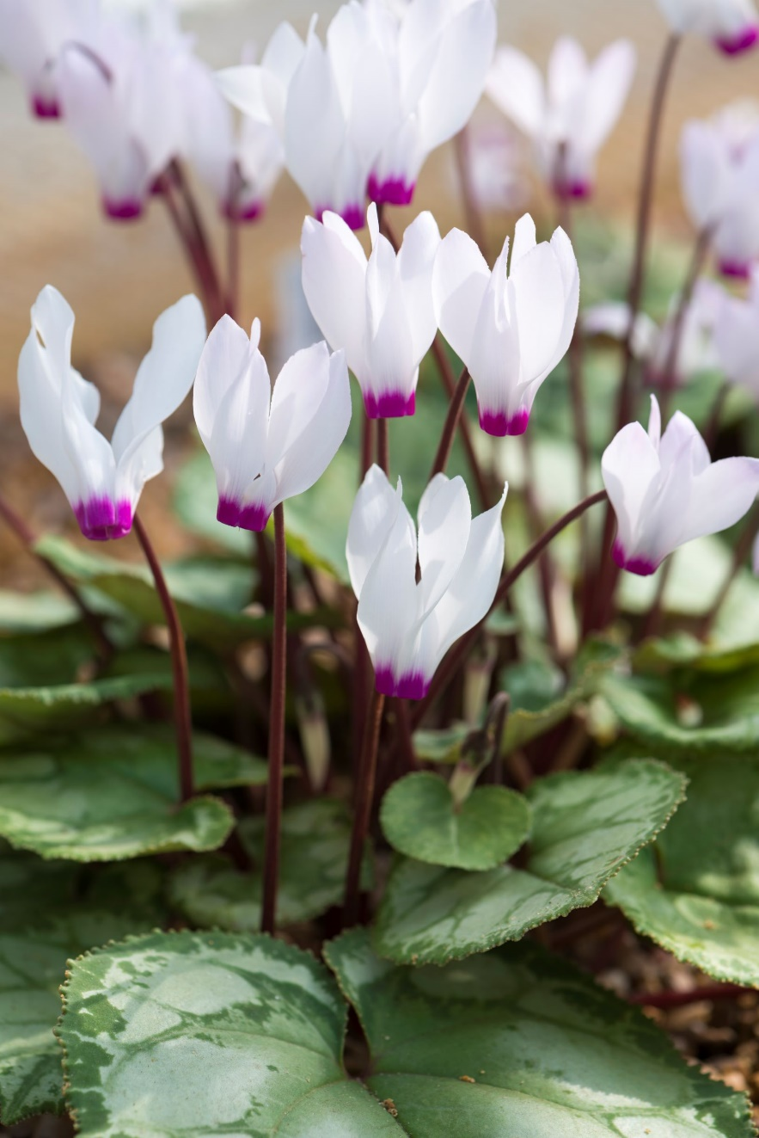
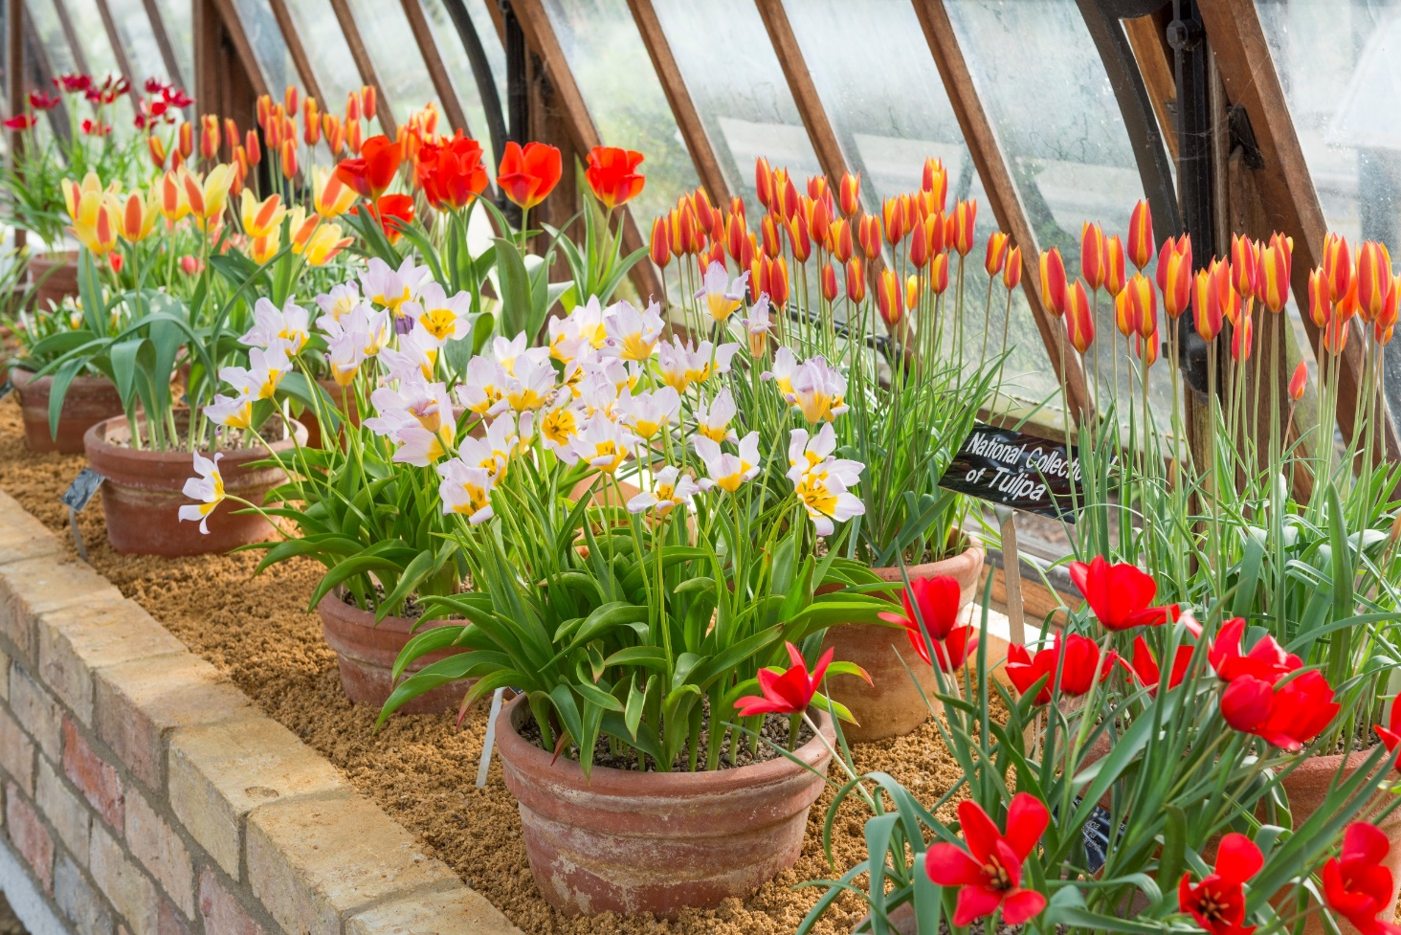
Life on a mountain
Notes:
Features of mountain plants to help them to live successfully in these conditions:
Strong, low growing shape to withstand snow and avoid the wind
Anti-freeze to stop leaves freezing solid!
Succulent leaves to store water
Hairy silver leaves to protect from the sun
Tough roots to grow in cracks between rocks
Live underground as a bulb
Left to right:
Tulip flowers, Cyclamen flowers

Slide 7
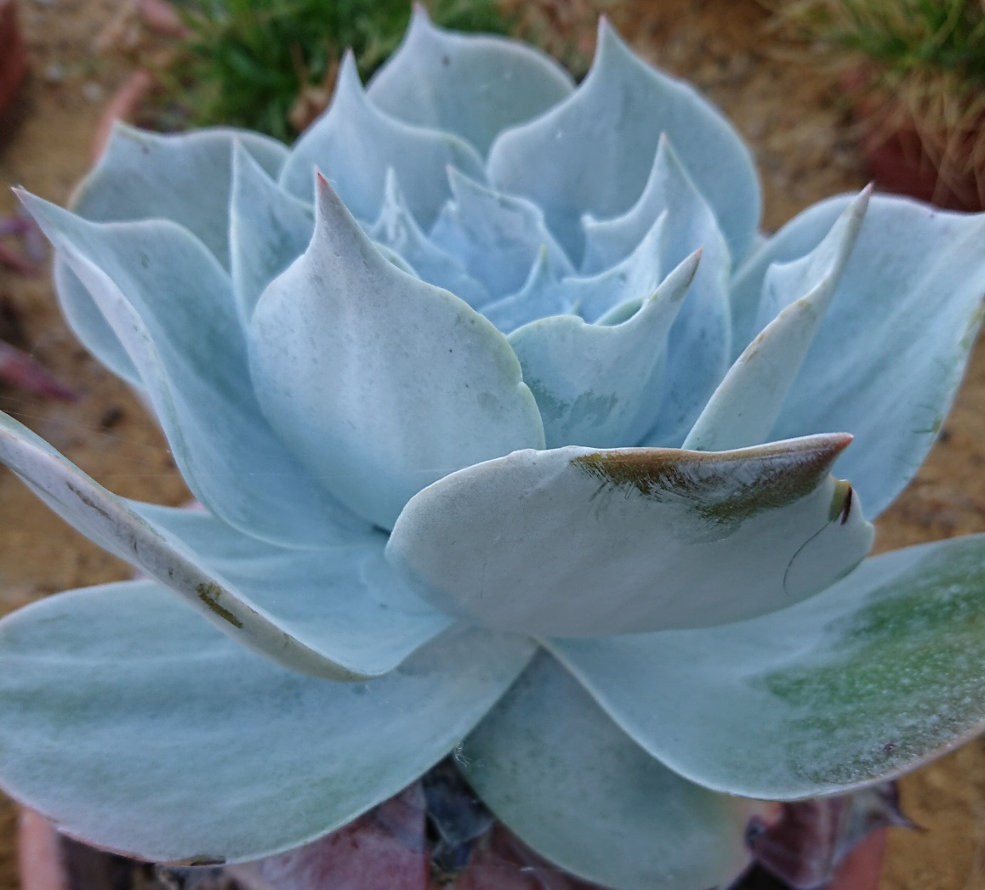
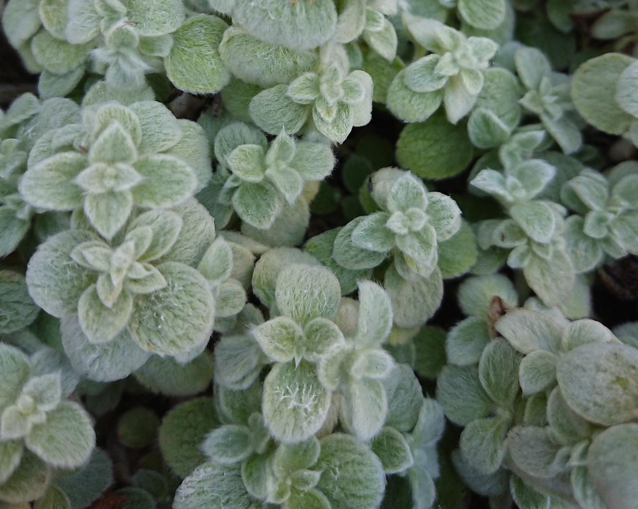
Life on a mountain
Notes:
Left to right:
Chalk lettuce leaves, White lambs ear leaves

Slide 8
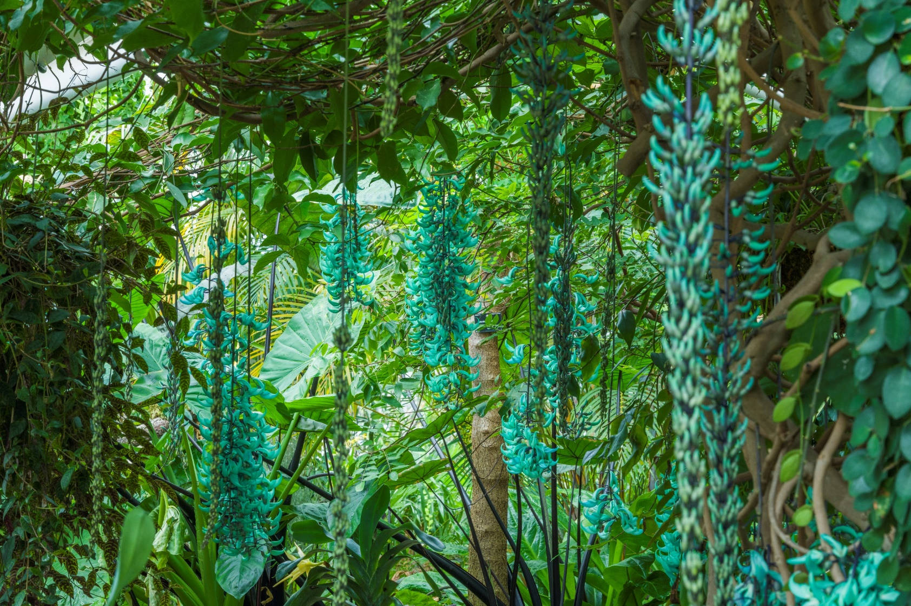
Life in a rainforest: what might it be like?
Wet and humid with lots of rain
Hot temperatures all the time
Competition for sunlight and space
Thin soils, rain storms
Notes:
Imagine you’re in a rainforest, what might it feel like? What might the conditions be like?
This photo is of part of the Tropical Rainforest glasshouse at Cambridge Botanic Garden. How would you describe what you can see?

Slide 9

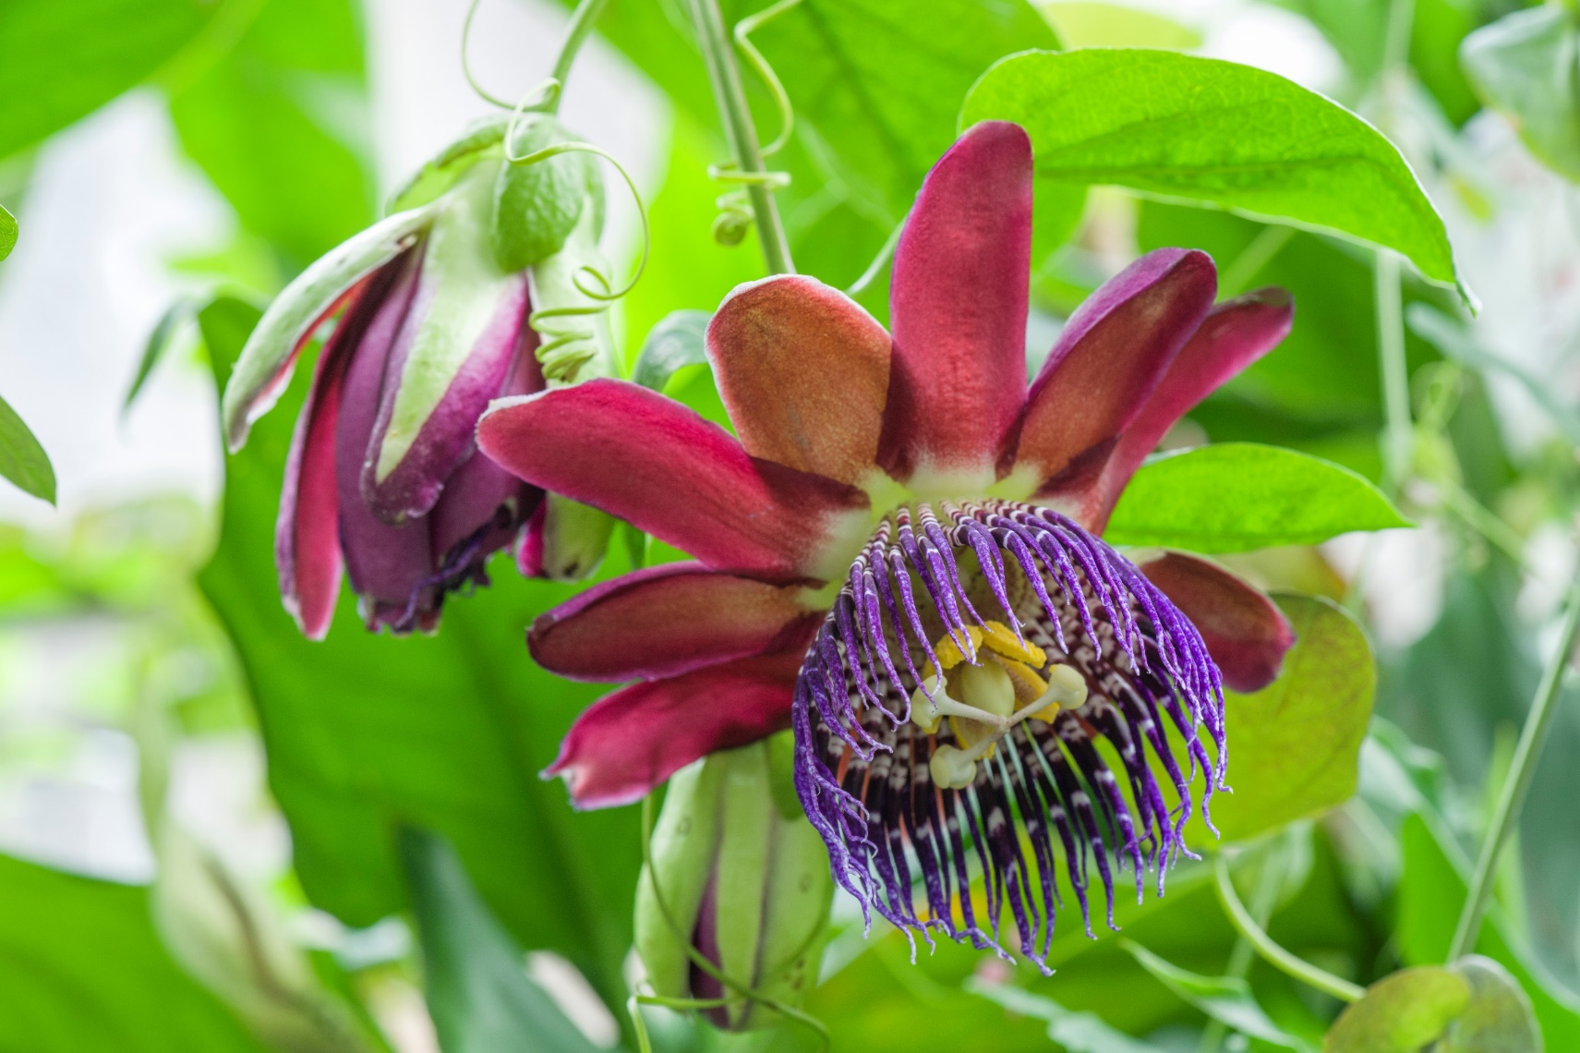
Life in a rainforest
Notes:
Features of rainforest plants to help them to live successfully in these conditions:
Big leaves to capture light
Waxy waterproof leaves with drip-tips to cope with the wet humid conditions and so they are able to shed water – if they remained waterlogged can be susceptible to algae and mould growing on the leaves and wouldn’t be able to photosynthesise.
Rainforest plants are fast growing– warm wet conditions make this possible.
Competition for space and light is high
Climbers and epiphytes (plants that grow on other plants) use other plants to get up high to reach the light without having to invest energy and time growing a trunk.
Buttress roots provide stability for trees in thin rainforest soils and provide a greater surface area to take up nutrients from the soil – rainforest soils are typically low in nutrients.
Some plants, such as bananas, have tough leaves designed to tear in storms to prevent the leaf being pulled off the plant.
Plants growing in the understorey and on the forest floor of the rainforest are able to cope with dense shade – some use special pigments in their leaves to reflect light back through the leaf- only 2% of the light available at the highest canopy level of the rainforest reaches the forest floor.
Left to right:
Giant taro leaf, Passionflower vine flower

Slide 10
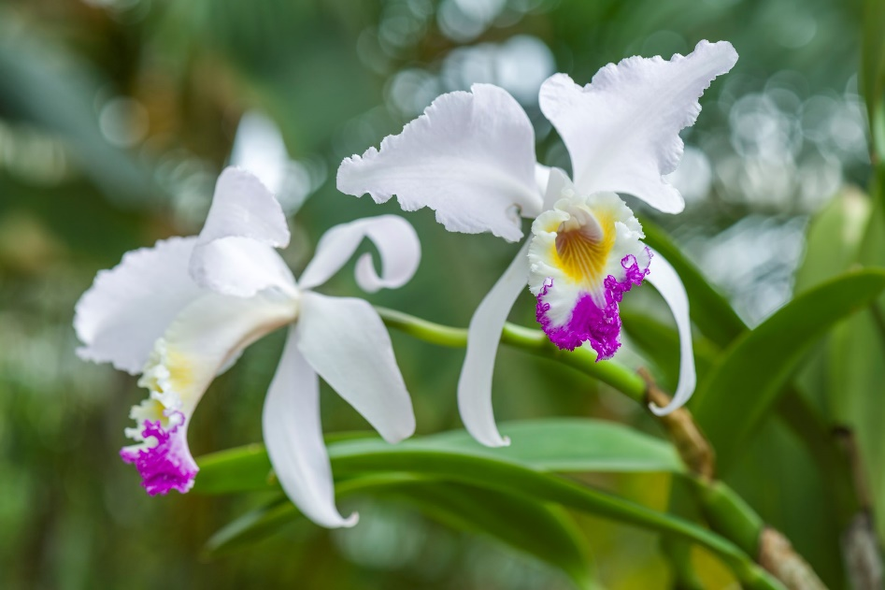
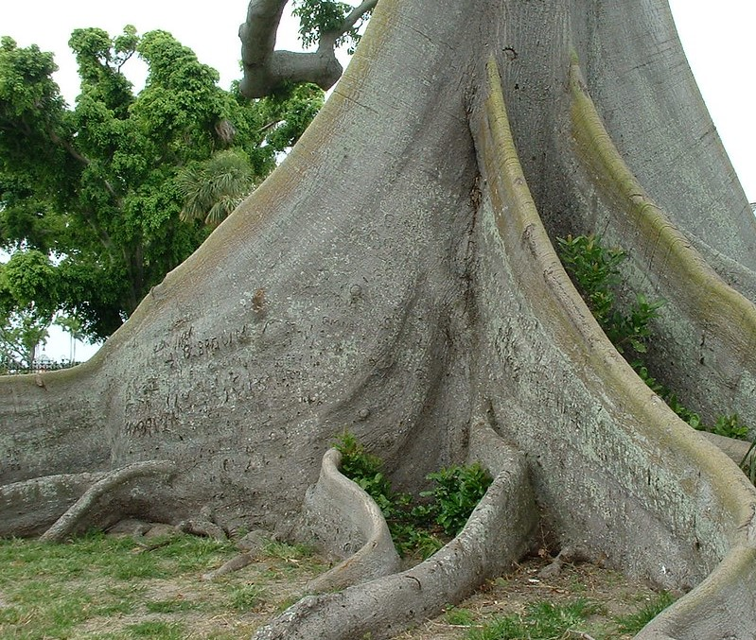
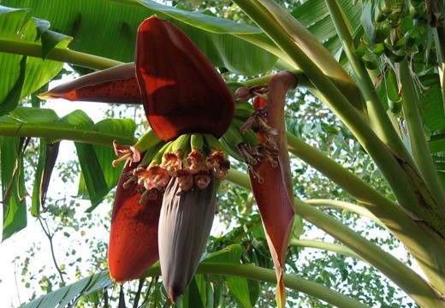
Life in a rainforest
Notes:
Clockwise left to right
Buttress roots of a Kapok tree, orchid flower, banana flower

Slide 11
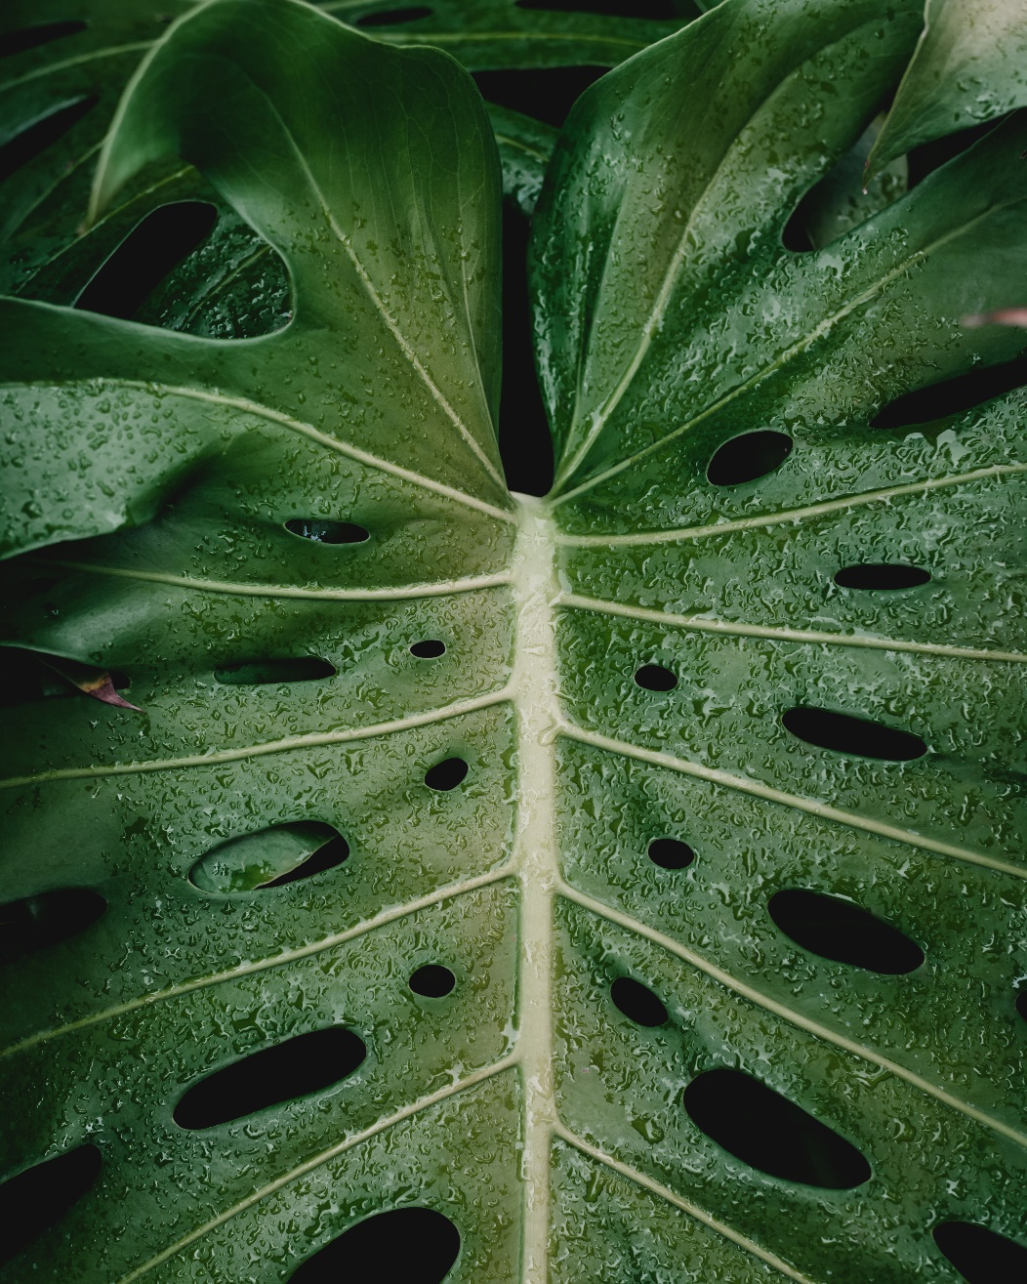
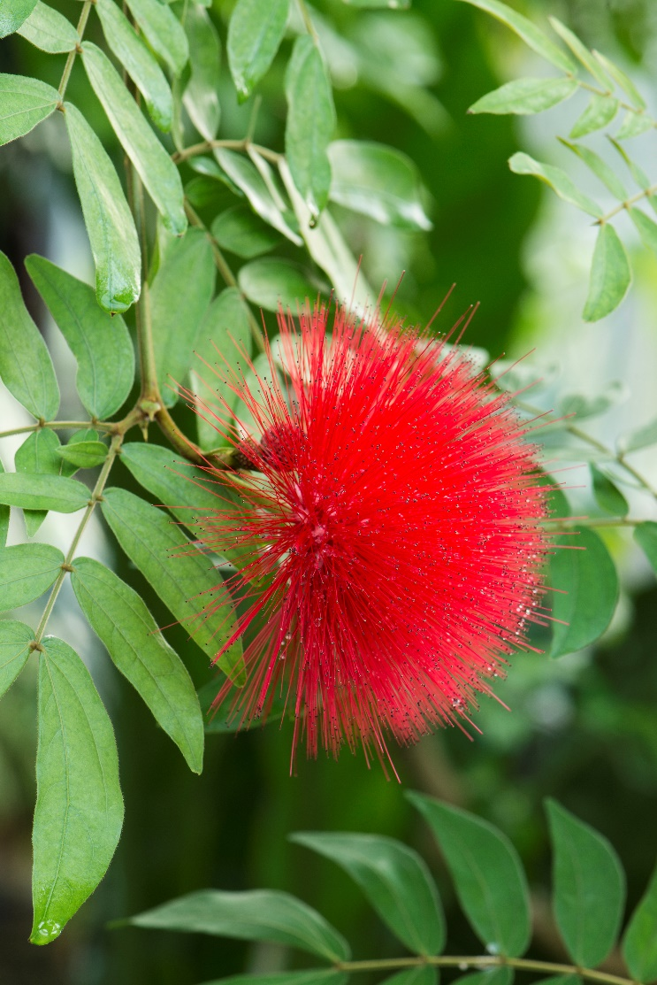
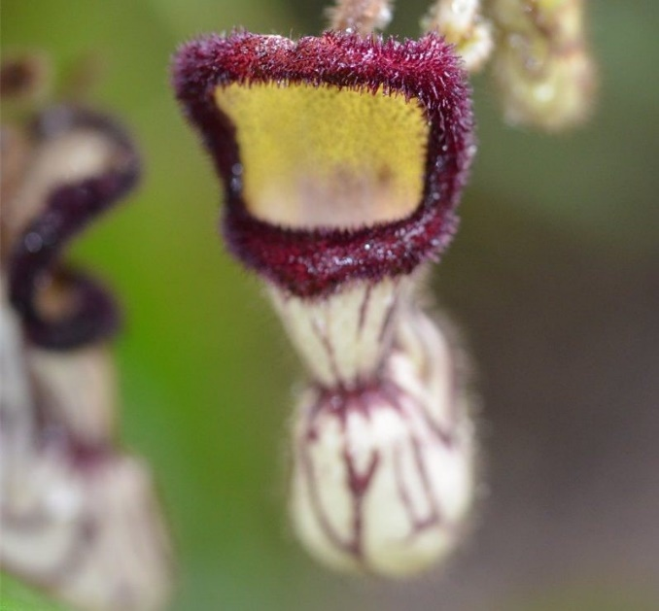
Life in a rainforest
Notes:
Left to right:
Powderpuff tree flower, Dutchman’s pipe vine flower, Swiss cheese plant leaf

Slide 12
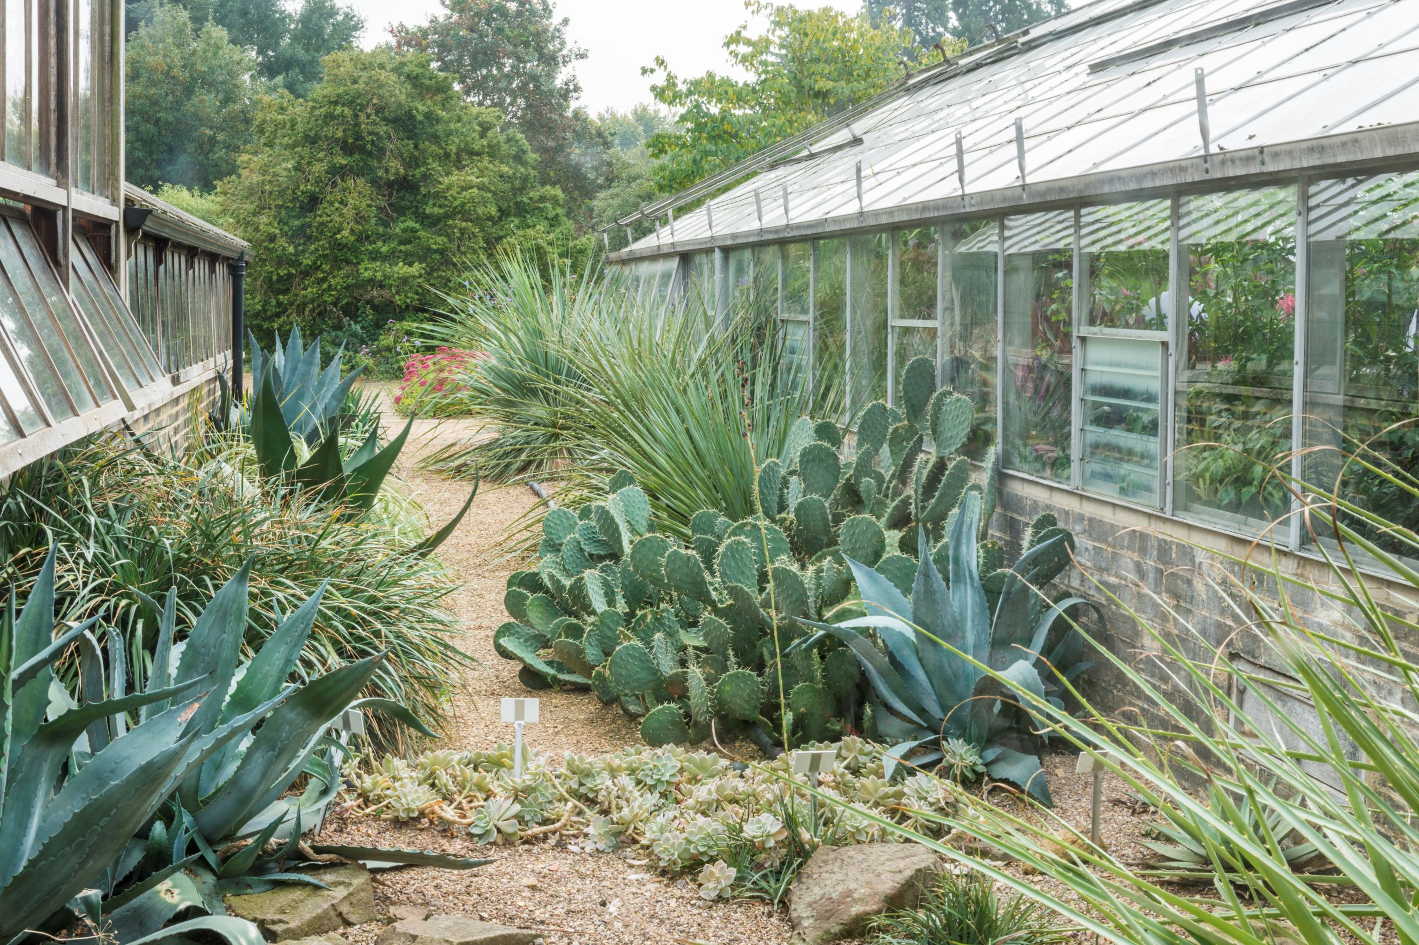
Life in a desert: what might it be like?
Dry and arid, hardly any rain
Hot during the day and cold at night
Strong sunlight
Sandy loose soil, dust storms
Notes:
Imagine you’re in a desertt, what might it feel like? What might the conditions be like?
This photo is of part of the Desert plantings between the glasshouse at Cambridge Botanic Garden. How would you describe what you can see?

Slide 13
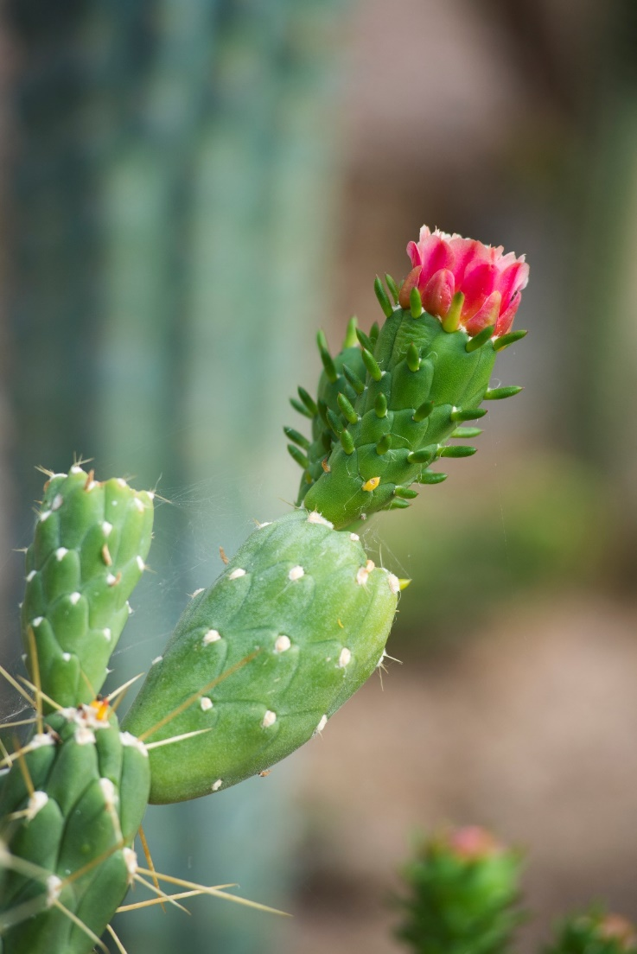
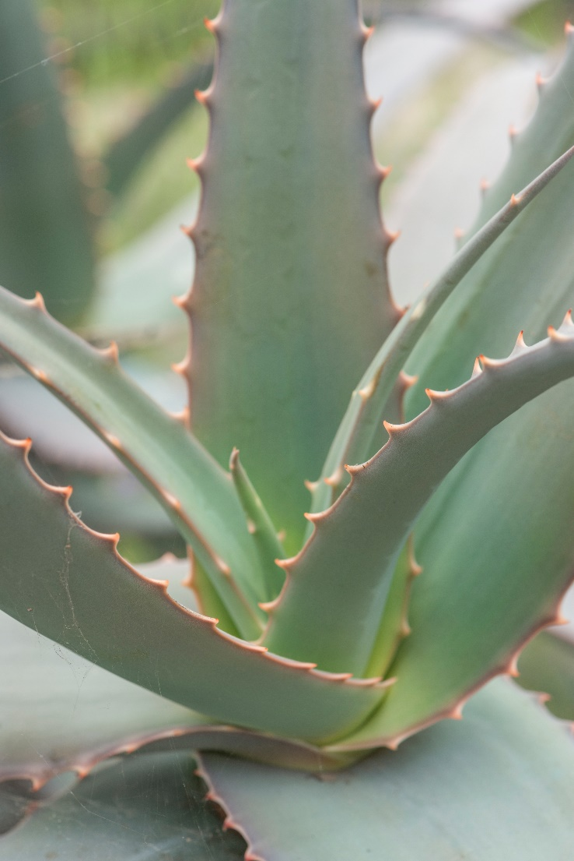
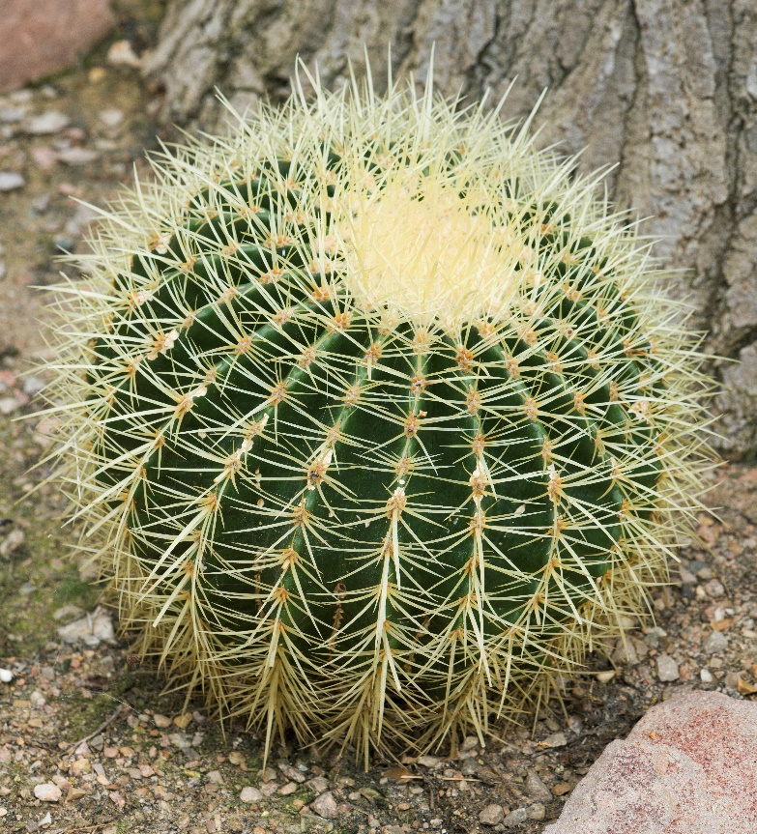
Life in a desert
Notes:
Features of rainforest plants to help them to live successfully in these conditions:
Deserts are not always hot. They often have extreme differences of temperature between the day when it is hot and the night when the temperature can drop. They are always dry though with not much water available in the soil for plants to take up through their roots. Arid means little or no rain.
Sandy desert soils are very free draining so any rain that falls, quickly drains away. Desert plants tend to either have long taproots to reach water far underground or mat like roots that cover a large area to maximise capture of any available water when rain falls.
Plants that store water in fleshy swollen stems and/or leaves (e.g. aloes and cacti) are called succulents. Cacti are just one type of succulent plant, all cacti are succulents but not all succulents are cacti. Some cacti have a concertina type stem which can expand to accommodate more water if it becomes available. Water is stored as a kind of jelly-like substance (think aloe vera gel if you’ve ever seen or used it). A common misconception among children is that if you cut open a succulent, water would just gush out like water out of a barrel.
Some desert plants produce pigments in their leaves or stem that act like a sunscreen. Typically these produce a red or purple colour.
Compare and contrast the three habitats:
Rainforests and deserts can both be very hot but rainforests are also humid with lots of water in the air. Deserts are always a dry heat, not humid. In rainforests it stays warm, deserts can be cold at night.
Both mountain and desert plants can have succulent fleshy leaves to store water as both habitats can be dry and plants in both habitats can be slow growing. Rainforest plants grow quickly.
Left to right:
Cactus with flower, Aloe, Golden Barrel Cactus

Slide 14
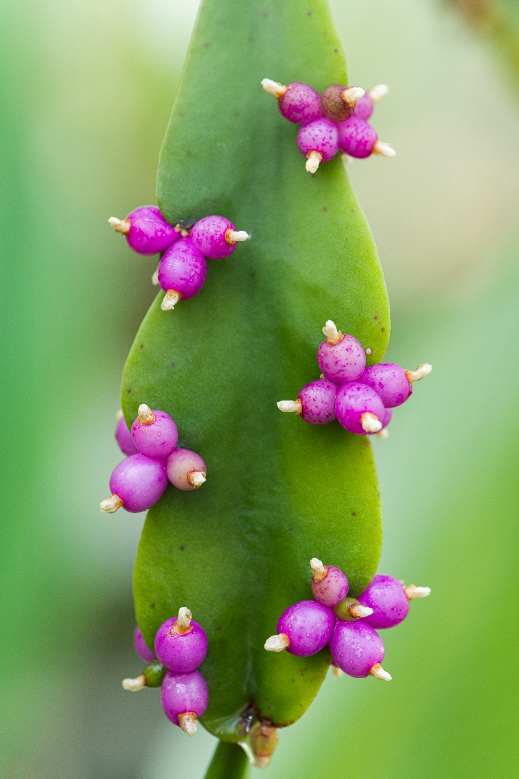
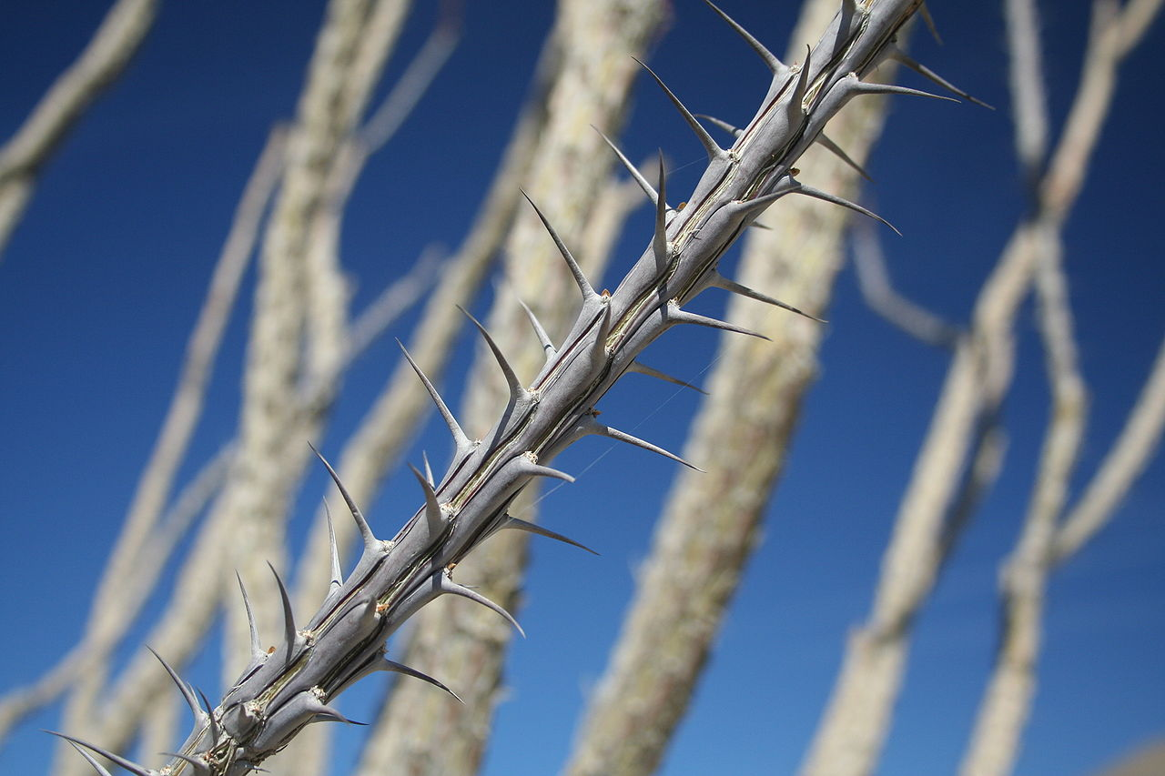
Life in a desert
Notes:
Left to right:
Ocotillo, cactus leaf with fruits

Slide 15
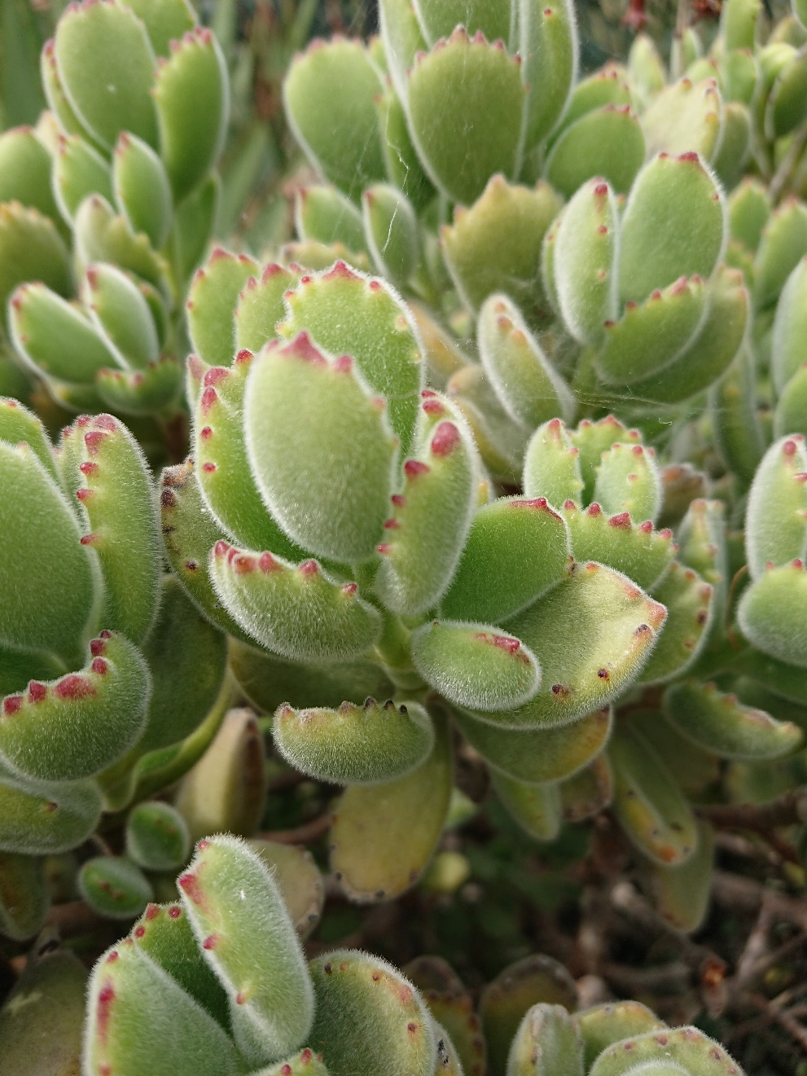
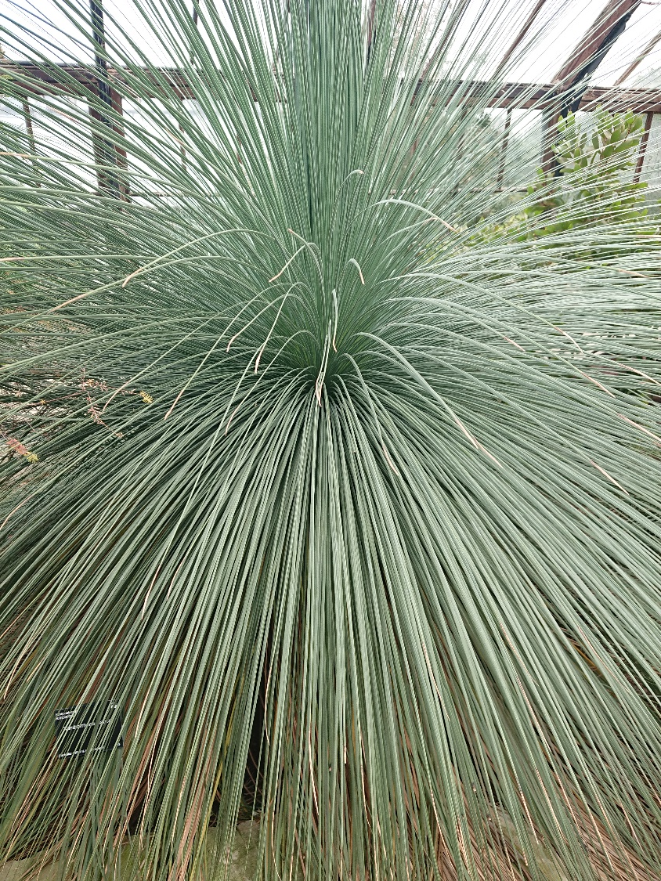
Life in a desert
Notes:
Left to right:
Grass tree, Bear’s paw

Slide 16
Plant defence
Plants can’t run away from something wanting to eat them. How might a plant defend itself to stop getting munched?
There are many adaptations that plants have developed to defend themselves.
Here are just a few different examples…
Notes:
Spines and hairs - cacti
Strong taste or poisonous/irritant
Camouflage – stone plant
Helpful animals – bull horn acacia

Slide 17
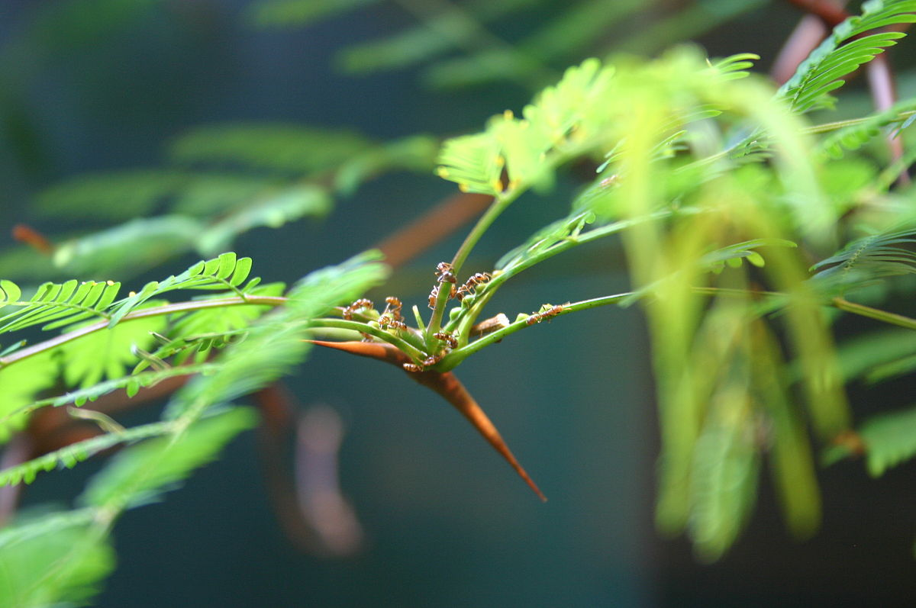
Plant defence
The Bull’s Horn Acacia is a small tree that has a special relationship with a type of Acacia ant.
The ants live inside hollow thorns on the tree. The tree grows little protein nodules on its leaves that the ants can eat and also provides them with nectar.
In return for a home and food, the ants will ferociously protect the tree from any animals trying to eat it by giving them a painful sting. They also clear away any seedlings that try to grow too close!

Slide 18
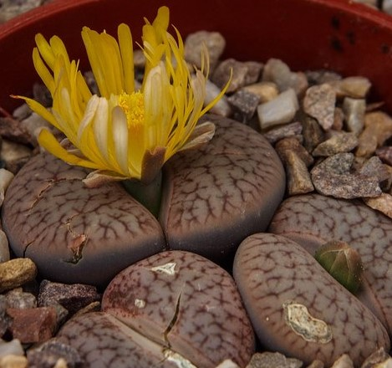
Plant defence
This is a Living stone plant. It is made up of two fleshy leaves and hardly any stem. It grows really close to the ground and is protected from being eaten by its clever camouflage – animals pass it by thinking its an inedible rock!
Part of the reason its so well camouflaged is because the green part of the leaf that the plant uses to catch sunlight and make its food is hidden deep inside the fleshy leaves. The top flat part of the leaf actually acts like a window and lets the light through to the green part hidden deep inside, out of sight from hungry animals!

Slide 19
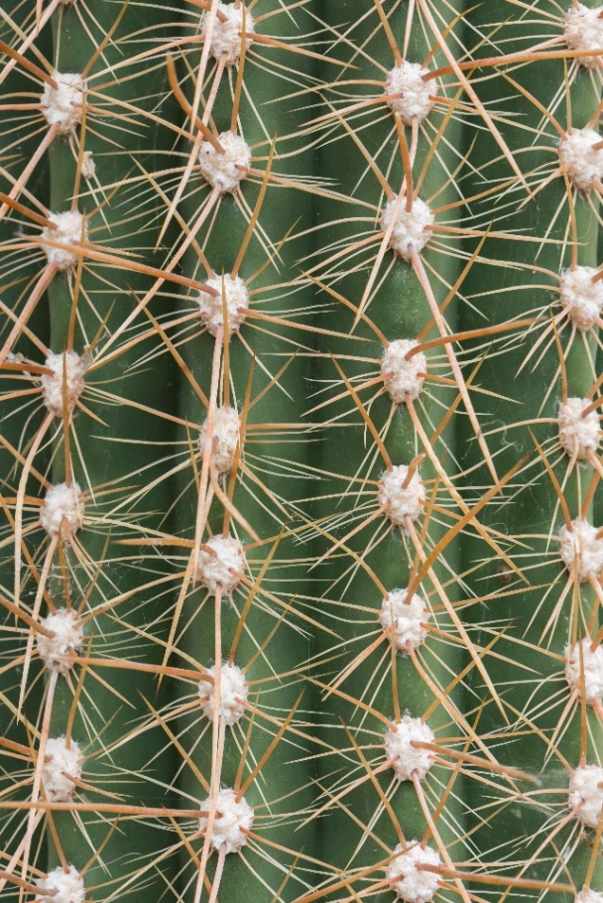
Plant defence
This is a close up of an Elephant Cactus.
Looking at this picture its pretty obvious why you wouldn’t want to take a bite – its covered in sharp spines! The way the spines are arranged on the plant means that every part of the cactus is protected.
Not all cacti have sharp tough spines to protect themselves, some use a type of hair-like spine called a glochid. Hairy cacti might look soft to touch but try it and those hairs will easily detach and work their way into your skin. They’re very small and fine and often have a barbed end so are very hard to get out again!

Slide 20
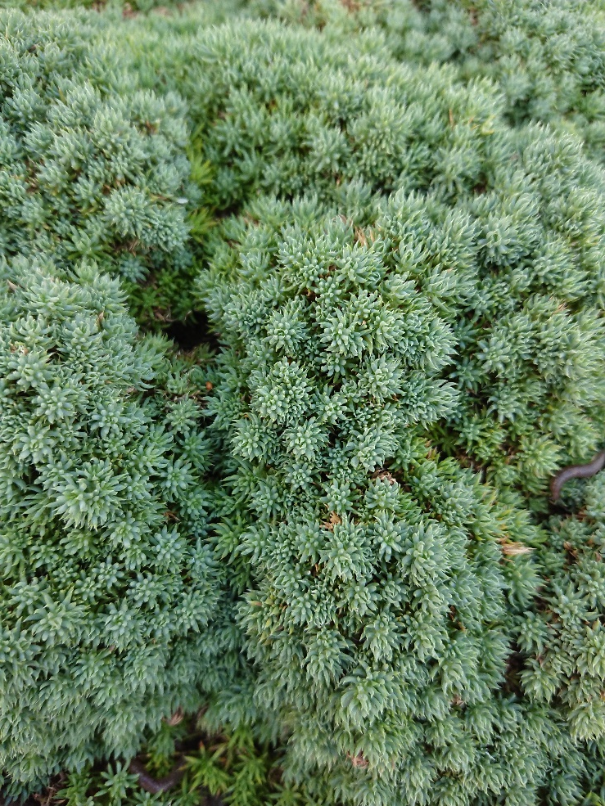
Plant defence
This is a Sintensis woodruff plant.
It may look pretty and like it would provide a refreshing juicy snack with all those succulent green leaves but be warned!
Inside its tasty looking leaves and stems is a cocktail of chemicals, poisonous to any animals who try to eat them.
Many plants contain chemicals which make them unpalatable or even poisonous to hungry animals or insects, a clever way to defend yourself without needing to move.

Slide 21
Compare and contrast: Mountain, Rainforest, Desert.
Which two habitats can be hot?
Rainforests and deserts can both be very hot but rainforests are humid with lots of water in the air. Deserts are arid (dry), not humid. Rainforests stay a more constant temperature but deserts can be very hot during the day and cold at night.
Which two habitats can have plants with fleshy leaves?
Both mountain and desert plants can have succulent fleshy leaves to store water as both habitats can be dry. Either because of lack of rain or because water is trapped as ice or snow.
Which habitat has the fastest growing plants?
Rainforest plants grow quickly to compete for space and light. Desert and mountain plants are often slow growing as they only grow when there is enough water and warmth.
Notes:
Compare and contrast the three habitats:
Rainforests and deserts can both be very hot but rainforests are also humid with lots of water in the air. Deserts are always a dry heat, not humid. In rainforests it stays warm, deserts can be cold at night.
Both mountain and desert plants can have succulent fleshy leaves to store water as both habitats can be dry and plants in both habitats can be slow growing. Rainforest plants grow quickly.

Slide 22
Your challenge: card sort
Read the information on each of the plant cards to find out about their amazing adaptations.
Use this information to sort and group the plants:
Into the different habitats they grow in (desert, rainforest or mountain)
Notes:
Options to add additional sorting of the cards into other groupings either specified or that the children come up with.

Slide 23
Next: create your own Superplant
Use what you have learnt plus your own imagination to design your own Superplant adapted to survive in the habitat conditions detailed at the top of the sheet.
You can draw your plant or model it out of playdoh. Don’t forget to give your plant a name!
Once you’re finished, share your plant design with the person sitting next to you. Which adaptations does your plant have, how do they help it to survive?

Slide 24
Finally: fill in the blanks worksheet
Once you’re finished, test your knowledge by having a go at the fill in the blanks worksheet.
Fantastic work! You’re now a plant adaptations expert!
And remember, plants all over the world have amazing adaptations, including the ones growing in your school grounds, your local park or in your garden. Remember to keep an eye out for plant adaptations near you!

